Slide 1
Parathyroid Disorders
Dr. Dulani kottahachchi
CONSULTANT ENDOCRINOLOGIST

Slide 2
Calcium Metabolism
Controlled by PTH & Vitamin D
Hypercalcaemia more common than hypocalcaemia
Detection of asymptomatic hypercalcemia is becoming commoner

Slide 3
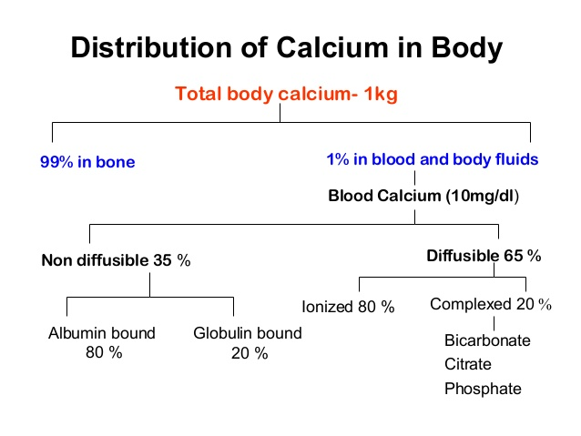

Slide 4
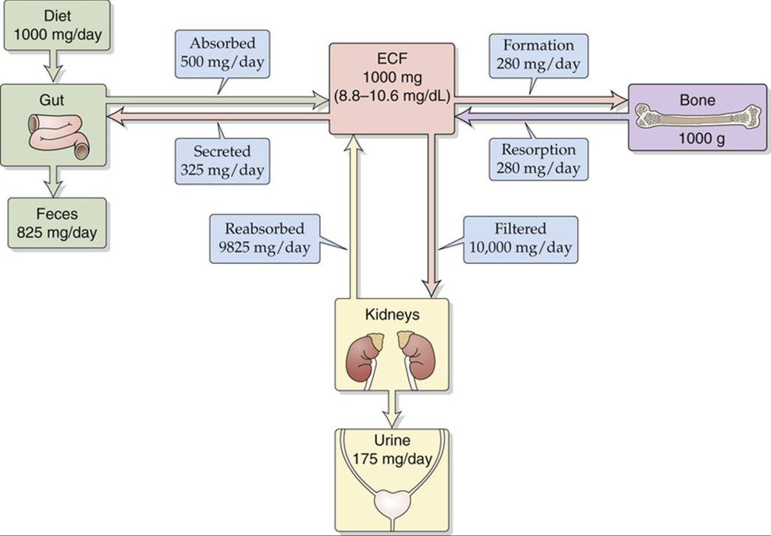
Calcium distribution

Slide 5
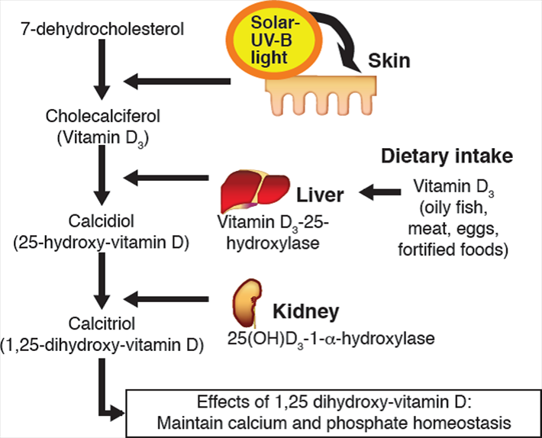

Slide 6
Parathyroid Hormone (PTH)
Regulator of calcium homeostasis
Secreted by 4 parathyroid glands
Low serum calcium stimulates release

Slide 7
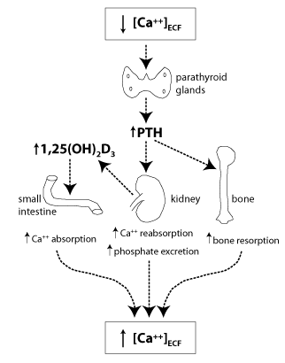
Actions of PTH

Slide 8
Hyperparathyroidism

Slide 9
May be - primary
secondary
tertiary

Slide 10
Primary Hyperparathyroidism
Common cause of hypercalcaemia
Single parathyroid adenoma (>80%)
Diffuse hyperplasia (15-20%)
Rarely – parathyroid carcinoma (<1%)
Causes ↑ S. calcium & ↓ S. phosphate
↑ 24 hour urinary calcium excretion

Slide 11
Secondary Hyperparathyroidism
Physiological compensatory hypertrophy of all parathyroid glands due to persistent hypocalcaemia
Due to – Vitamin D deficiency
Chronic kidney disease (early)
When cause of hypocalcaemia is corrected PTH becomes normal

Slide 12
Tertiary Hyperparathyroidism
Long standing secondary hyperparathyroidism → autonomous PTH secretion
eg. chronic kidney disease (advanced)
Causes ↑ s. calcium & ↑ s. phosphate

Slide 13
Causes of Hypercalcaemia
Excess PTH – primary, tertiary, ectopic
Malignancy – myeloma, bone secondaries
Excess Vitamin D – oral, granuloma, lymphoma
Excess Calcium - oral
Other endocrine disease (mild) – thyrotoxicosis, Addison’s disease
Drugs – thiazides, Vitamins A & D analogues, Lithium
Long term immobility

Slide 14
Severe hypercalcaemia (> 3 mmol/L)
malignant disease
hyperparathyroidism
advanced CKD
vitamin D toxicity

Slide 15
Clinical Features of Hypercalcaemia
Mild - usually asymptomatic
Tiredness, malaise, dehydration, depression
Renal colic (stones), polyuria, nocturia, haematuria, hypertension
Bone pain, bone cysts & ‘brown tumours’
Abdominal pain
Chondrocalcinosis & ectopic calcification
Corneal calcification

Slide 16
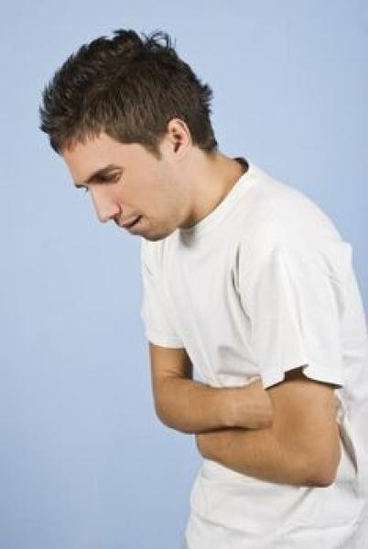
Moans, Groans, Bones, Stones!

Slide 17
Clinical Features of Hypercalcaemia
Symptoms from underlying cause
Malignant disease usually advanced when hypercalcaemia occurs
Common primary tumours - bronchus, breast, myeloma, oesophagus, thyroid, prostate, lymphoma, renal cell carcinoma
True 'ectopic PTH secretion' by a tumour is v.rare
(PTH-related protein)

Slide 18
Investigations - Biochemistry
Fasting serum calcium & phosphate – several
Serum PTH
Arterial blood gas - hyperchloraemic acidosis
Renal functions – usually normal
24 hour urinary calcium – look for hypocalciuric hypercalcaemia
↑ ALP – severe parathyroid bone disease

Slide 19
Differential Diagnosis
protein electrophoresis - myeloma
serum TSH - hyperthyroidism
0900 h cortisol and/or ACTH test - Addison's disease
serum ACE - sarcoidosis
hydrocortisone suppression test - sarcoidosis, vitamin D-mediated hypercalcaemia, some malignancies

Slide 20
Investigations - Imaging
X-ray abdomen – renal calculi nephrocalcinosis
X-ray hands – subperiosteal erosions in middle & terminal phalanges
DXA bone density scan
Parathyroid imaging - ultrasound scan
high resolution CT or MRI radio-isotope scan

Slide 21
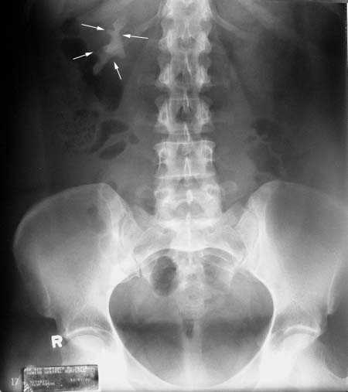
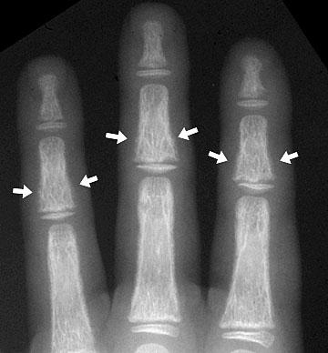
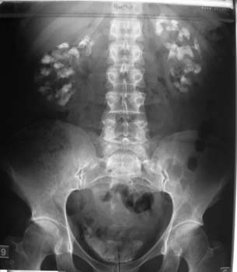

Slide 22
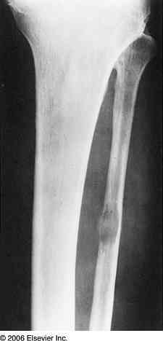
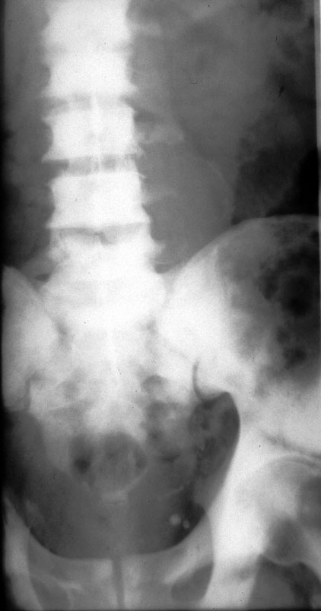
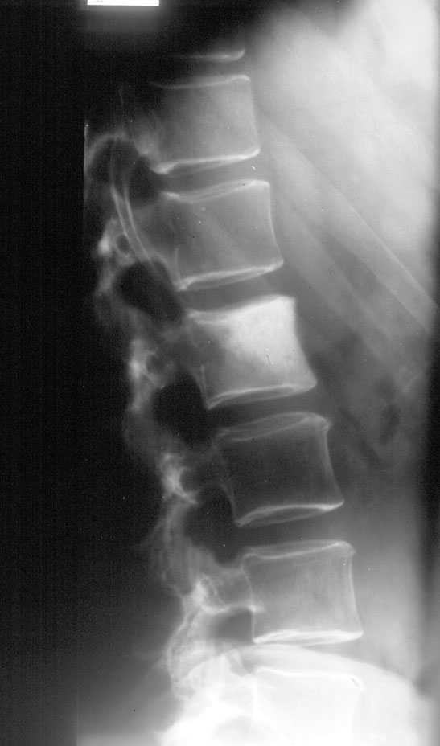
Bone Mets

Slide 23
Treatment
Emergency treatment of severe hypercalcaemia
Treatment of hyperparathyroidism

Slide 24
Treatment of Acute Severe Hypercalcaemia
Presentation – dehydration, nausea & vomiting, nocturia, polyuria, drowsiness, altered consciousness
Hydrate adequately
4-6 L N.Saline on D1, 3-4 L/day thereafter
IV Pamidronate – treatment of choice
Calcitonin - short duration of action
Prednisolone - 30-60 mg daily
Oral Phosphates - causes diarrhoea

Slide 25
Treatment of Primary Hyperparathyroidism
Medical –
high fluid intake
avoid high calcium & Vitamin D intake regular exercise
agents that target calcium-sensing receptors
(e.g. cinacalcet) - parathyroid carcinoma, dialysis

Slide 26
Treatment of Primary Hyperparathyroidism
Surgical Removal – indications are,
renal stones
impaired renal function
bone involvement
marked ↓ in cortical bone density
marked hypercalcaemia
<50 yrs of age
previous episode of acute severe hypercalcaemia

Slide 27
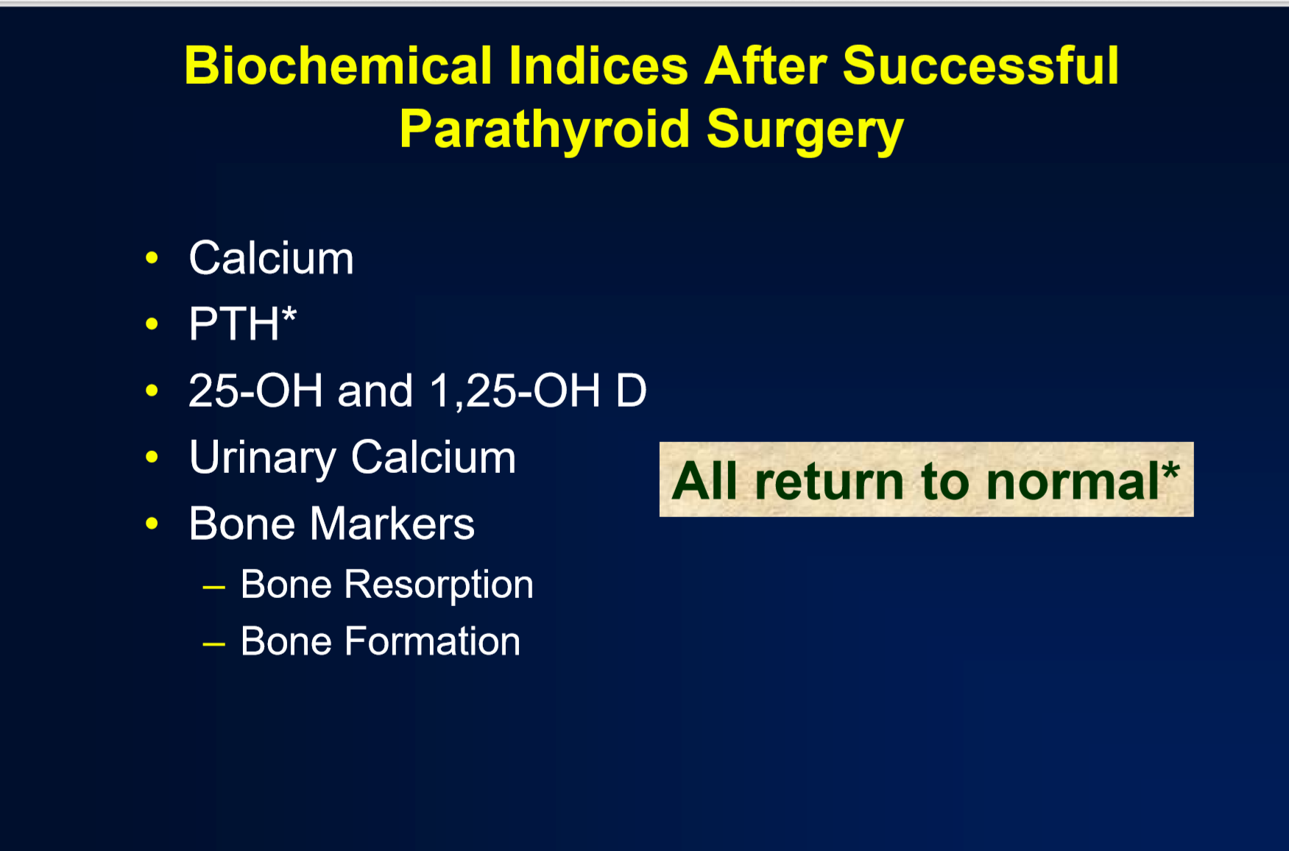

Slide 28
Treatment
Secondary hyperparathyroidism →
treat cause
Tertiary hyperparathyroidism → parathyroid resection surgery

Slide 29
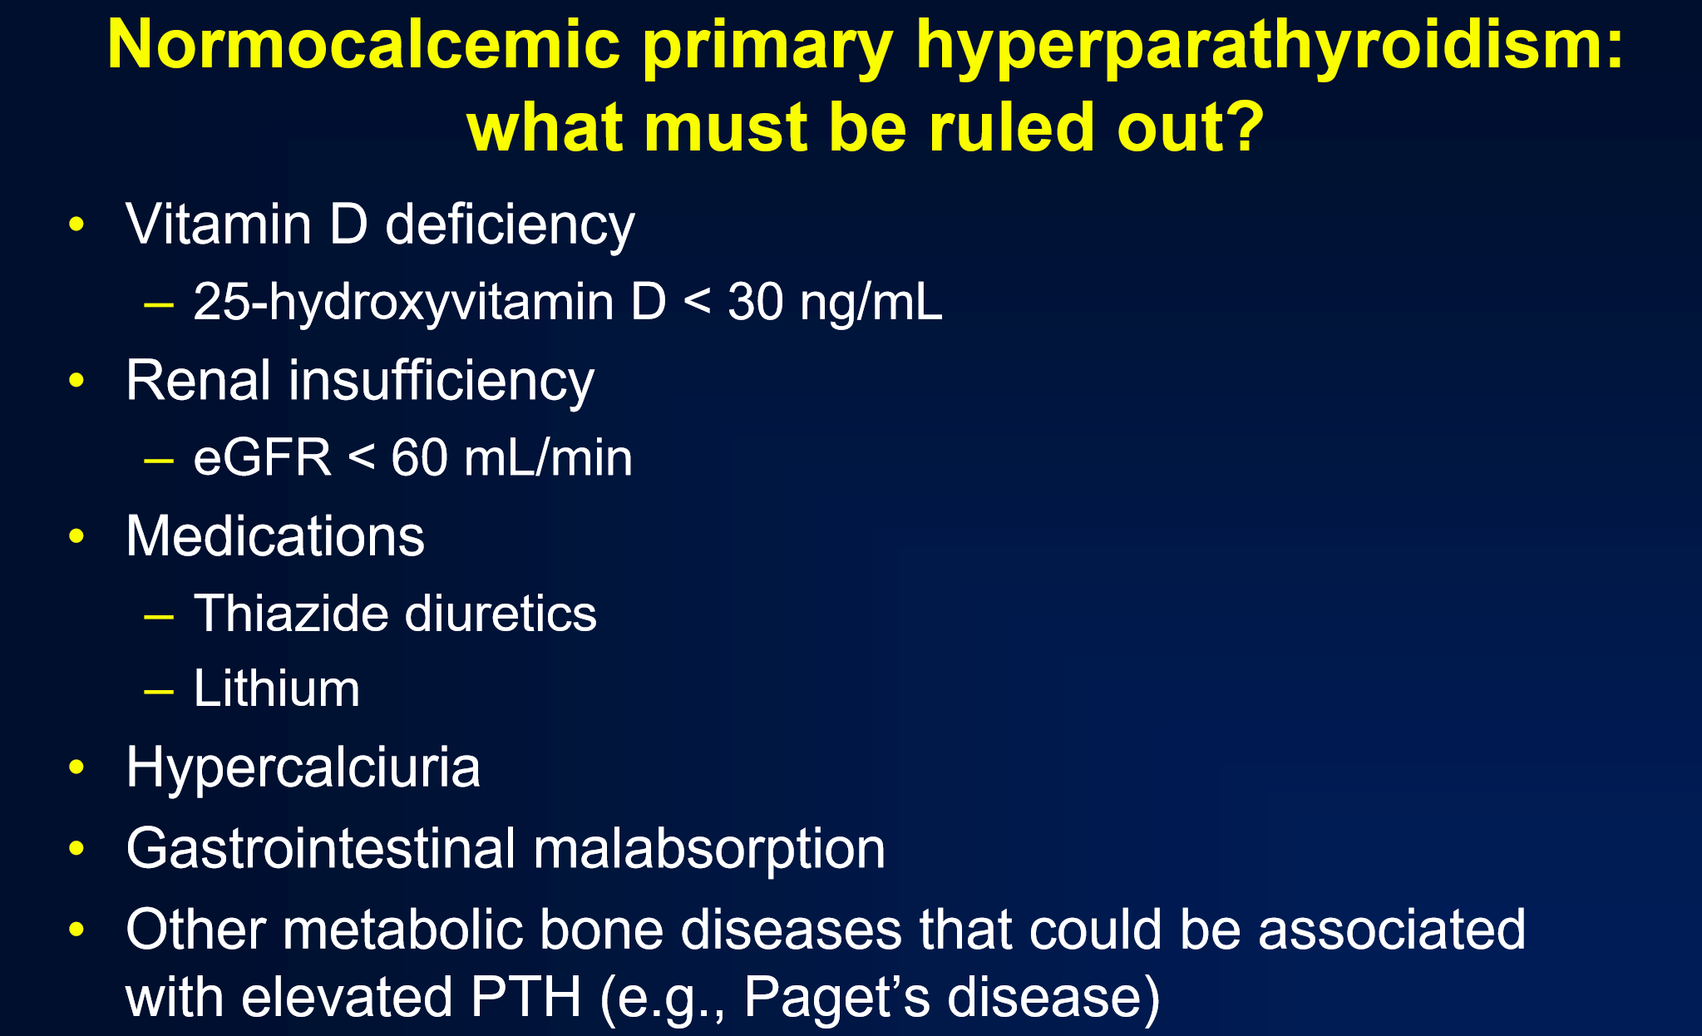
Normocalcemic hyperparathyroidism

Slide 30
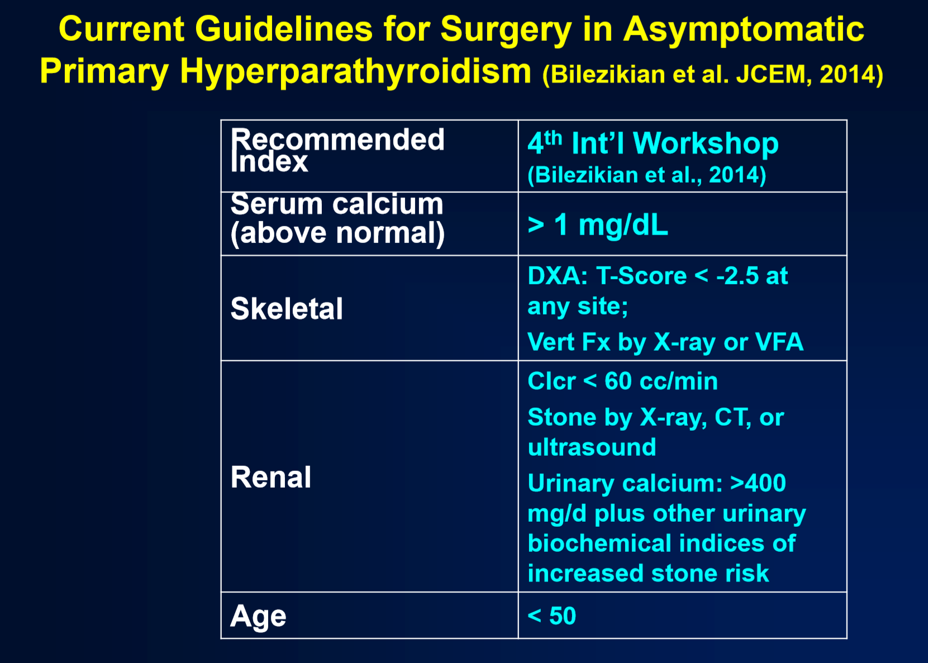

Slide 31
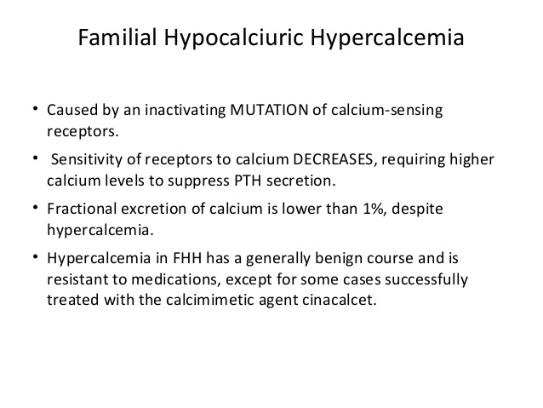

Slide 32
Hypoparathyroidism

Slide 33
Causes
Destruction / damage of parathyroid glands
post thyroidectomy or post parathyroidectomy
autoimmune
radiation
Failure of parathyroid development
Failure of PTH secretion
severe hypomagnesaemia
Failure of PTH action

Slide 34
Types
Primary (Idiopathic) Hypoparathyroidism
Pseudo Hypoparathyroidism
Pseudo-pseudo Hypoparathyroidism

Slide 35
Primary Hypoparathyroidism
↓ S.calcium with ↑ S.phosphate
Associated with other autoimmune disorders in Polyglandular Autoimmune Syndrome –
vitiligo, cutaneous candidiasis

Slide 36
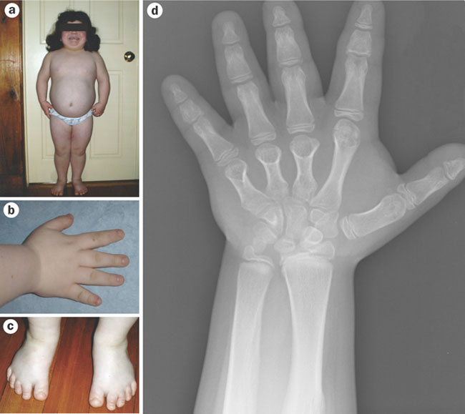
Pseudo Hypoparathyroidism
End organ resistance to
PTH
Short stature
Short metacarpals
Subcutaneous
calcification
Intellectual impairment

Slide 37
Pseudo-pseudo Hypoparathyroidism
Phenotype similar to those with pseudo hypoparathyroidism
But calcium metabolism is normal

Slide 38
Other Causes of Hypocalcaemia
Increased phosphate levels –
Chronic kidney disease (common)
Phosphate therapy
Vitamin D deficiency –
Osteomalacia / rickets, Vitamin D resistance
Drugs – Calcitonin, Bisphosphonates
Misc - Acute pancreatitis (common)
Citrated blood in massive transfusion (common)
Low plasma albumin (malnutrition, CLCD) Malabsorption (coeliac disease)

Slide 39
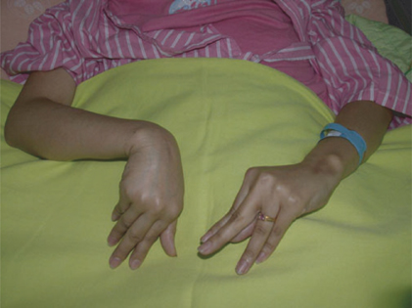
Symptoms of Hypocalcaemia
Paraesthesiae of hands and feet
Circumoral numbness
Cramps, anxiety & tetany
Convulsions
Laryngeal stridor
Dystonia
Psychosis

Slide 40
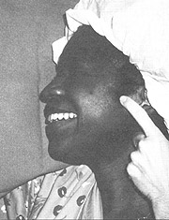
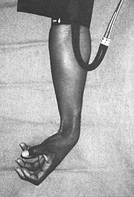
Signs of Hypocalcaemia
Chvostek’s sign
Trousseau’s sign
Papilloedema
Cataracts
(prolonged QT on ECG)

Slide 41
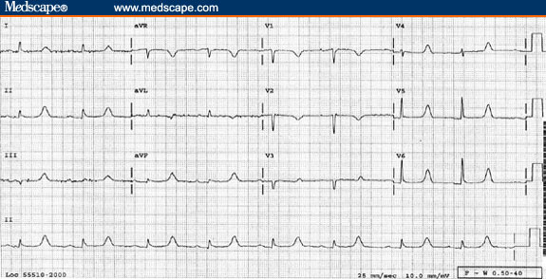
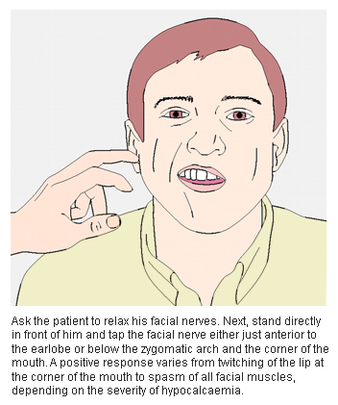
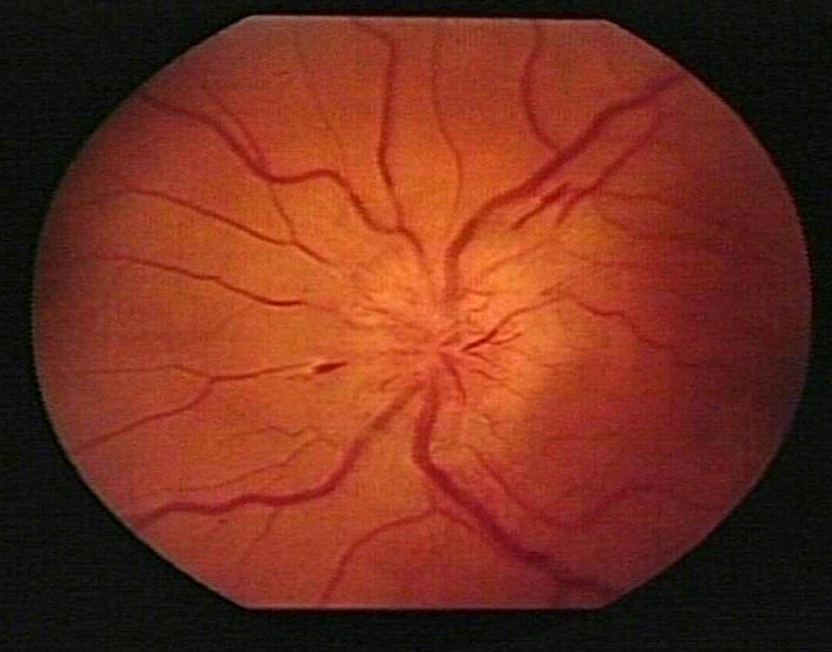

Slide 42
Investigations in Hypocalcaemia
Serum calcium & phosphate
PTH – absent/low in hypoparathyroidism
high in other causes of hypocalcaemia
S.creatinine
Serum 25-hydroxy Vitamin D – low in vitamin D deficiency
S.magnesium
X ray of hands – short 4th metacarpals in pseudo hypoparathyroidism

Slide 43
Management of Hypoparathyroidism
Alpha-hydroxylated derivatives of Vitamin D
– eg alfa calcidol
Calcium supplements
Regular monitoring of S. calcium/urine calcium: creatinine ratio

